Slide 1
GitLab and GIT
Basic Fundamentals

Slide 2
Outlines
What is GIT.
Why is everyone using GIT.
GIT Concept.
GIT Commands.
Brief Case study in GitLab.
Cheat Book for GIT.

Slide 3
What is GIT
Git is a fast, scalable, distributed revision control system with an unusually rich command set that provides both high-level operations and full access to internals.
Git is a version-control system for tracking changes in computer files and coordinating work on those files among multiple people. It is primarily used for source-code management in software development.

Slide 4
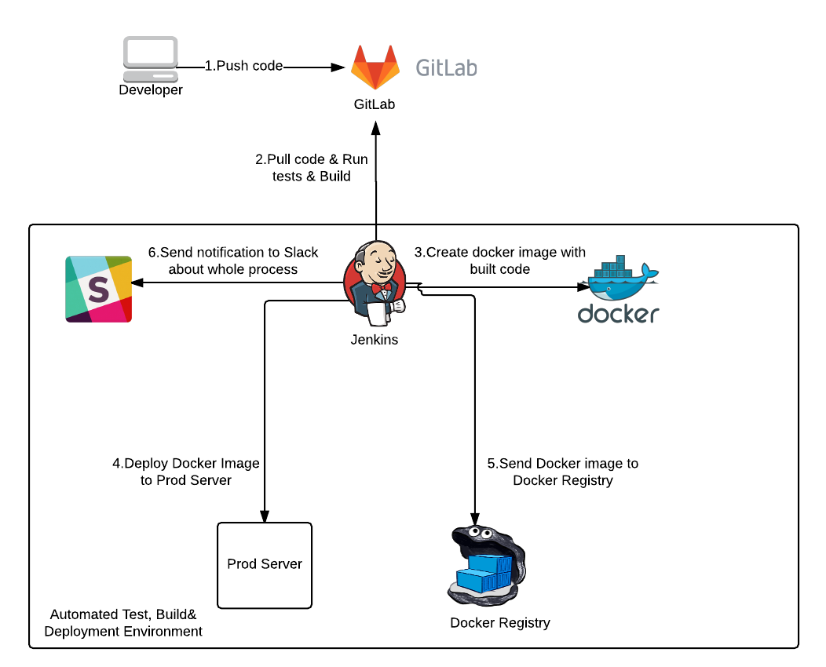
Why everyone is using GIT

Slide 5
Why everyone is using GIT
Branching: Branching means you diverge from the main line of development and continue to do work without messing with that main line.
Local: A local branch is a branch that only you (the local user) can see. It exists only on your local machine.
Fast: It is fast to manage the code in local machine and push, merge in master file when needed.
Distributed: Several branches can work on single master repository.
Small:
Staging Area
Workflows
Popularity-Github, Bigbucket

Slide 6
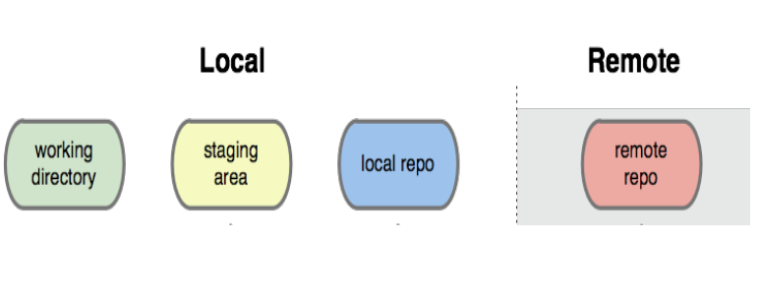
GIT Concept

Slide 7
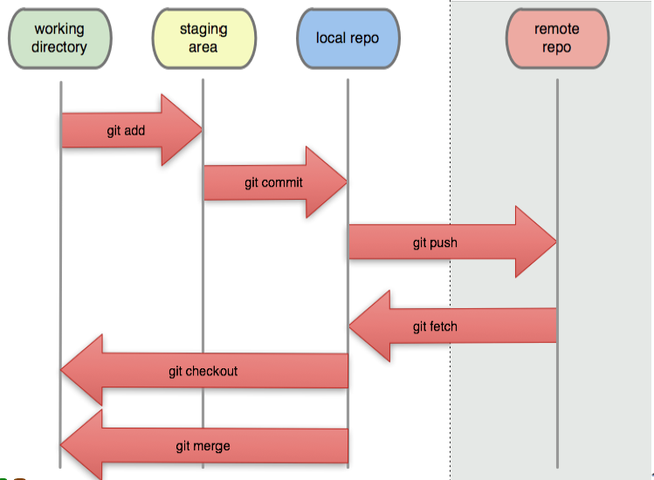
GIT Concept(Continue..)

Slide 8
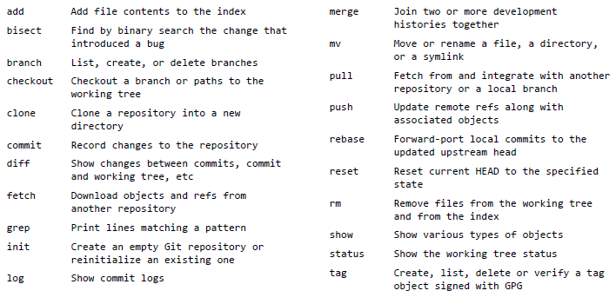
Common GIT Commands

Slide 9
Hands On Git Commands

Slide 10
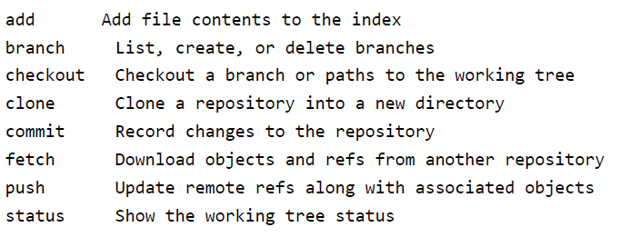
Common GIT Command We will Cover

Slide 11
Case 0: Installing GitLab in Linux
GitLab to be installed with the terminal using apt-get command
-> sudo apt-get update
-> sudo apt-get install –y curl openssh-server ca-certificates
-> curl –sS https://packages.gitlab.com/install/repositories/gitlab/gitlab-ce/script.deb.sh | sudo bash
Sudo EXTERNAL_URL=http://localhost:80/ apt-get install gitlab-ce
Access the gitlab using:
http://localhost:80/
You need to provide the root administrative user password for the GitLab.
Now with Gitlab installed and our access established, we can explore how its features will allow your team to make better use of Git.

Slide 12
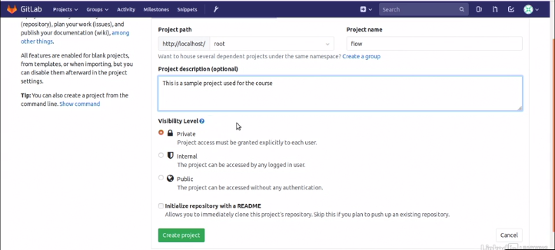
Case1: Overview and first repository
This slide will provide a high-level overview of GitLab and shows you where to find major features within the tool. Projects are a core concept within GitLab. Once you establish a project, GitLab provides a wide set of features such as a code repository, issue trackers, wikis, and CI/CD tooling to support the project.
Click on the create project and the first thing that we'll need to do is provide a name for our project. I'm simply going to call this project flow.

Slide 13
Case1: Overview and first repository
We can specify a visibility level for the project. This will determine how exposed your project is to other users.
We select private project that will only be available to users we grant access, explicitly, to the project. When we build out a project, we can also choose to initialize a README file within the repository. And create project.
You'll notice the left-hand side bar contains a repository. This is where our code will be stored for the project. The interface allows you to look through the different branches found within the repository from the main screen, or you can find the branches on the side bar. Additionally, you can look at the code from various different aspects. You can see the latest commits that were provided to your project.

Slide 14
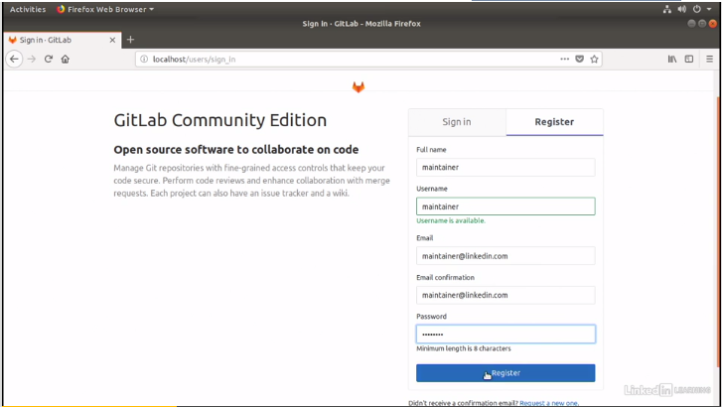
Case 3:Create user account set-up
When starting out with GitLab, the first thing a team should do is setup user accounts. User accounts allow team members to log into the tool and are used to control their access and privileges on specific projects.
Within GitLab there's two way to create an account. First, a team member can register for an account on their own through the splash page for the tool.

Slide 15
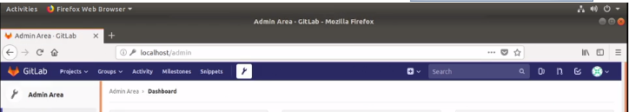
Case 3:Create user account set-up
So what we're going to do is build a maintainer account.
The maintainer account is going to represent our team member who has commit privileges on every branch within the repository. They're going to be the folks performing the merge request from the contributors. So we go ahead and set up our maintainer account.
Another way is by administrator. So an administrator can create an account for a new user. So we're going to log in as root and once we're logged in we're going to access the administration area for GitLab by clicking the little wrench at the top of the screen.

Slide 16
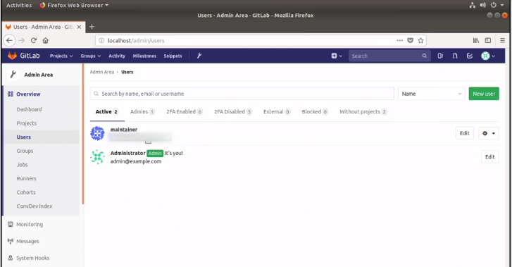
Case 3:Create user account set-up
If we take a look now at the sidebar, you're going to see the user's section appear. We already see the maintainer account that we've created, and we're going to go ahead and build a new user account, this time for a contributor. The contributor account is going to represent those developers on our team that lack commit access and need to work through a maintainer in order to have their feature branches integrated within the major development branches in our repository.

Slide 17
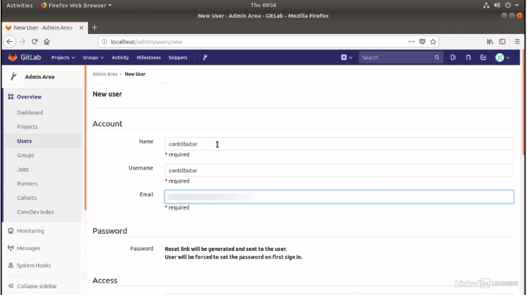
Case 3:Create user account set-up
So we just need once again to provide simple pieces of information. The name, the username and the email for contributor. From there if we'd like we can set up additional access for this user. We can make them an administrator if we want them to have higher lever privileges, however for this user, they can stay as a regular user or one of developers on our project.Once we've completed the form, all we have to do is click the create user button at the bottom of the screen and we see that the new user is established.

Slide 18
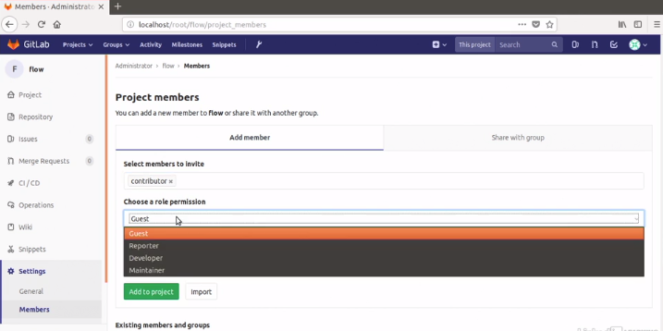
Case 3:Create user account set-up
Within the flow project we can scroll down on the sidebarand under settings we find the member's area. This allows us to assign different users to the project.
So let's first assign the contributor to the project and we need to select a permission level for this user on the project. We're going to go ahead and make our contributor a developer. This will give them push permissions and commit permissions on branches within the repository that are not protected. Once we've established their permission level, we can click on add to project and they're now assigned.
Similarly we can assign the permission for maintainer as Maintainer.

Slide 19
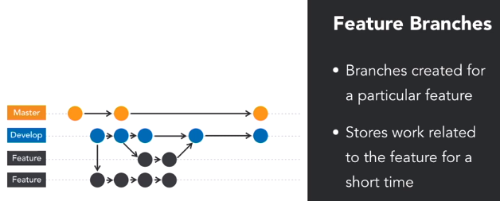
Case 4: Branching Strategies
Git's branching model is one of the most powerful available amongst version control systems. Its flexibility allows teams to easily create various types of branches that establish workflows.
Using Git branches, we can quickly fork the code base to work on a new feature while maintaining the original source code in a separate line of code. So, this allows us to experiment on a new feature in a separate area. Depending on our workflow, we may need to leverage several types of branches. Let's talk about those now. First, let's discuss long-running branches. Long-running branches always remain open, storing the history of a particular line of development.

